Slide 1
PROJECT MANAGEMENT

Slide 2
BACKGROUND
Project management is a common discipline in tech.
Many developers often report to nobody other than a PM.
Their job is to make sure that features are moving forward in a timely manner.
They talk to the customers, remove blockers, and update the Jira boards.

Slide 3
GREENFIELD VS BROWNFIELD PROJECTS
Greenfield projects are more like new projects, meaning they have no restraints from prior infrastructures or past projects.
Brownfield projects are more like modification projects, where you are limited by what you can do by the existing infrasctructures and restraints of existing systems.

Slide 4
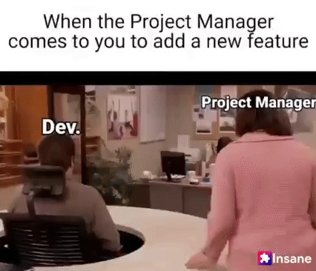

Slide 5
